Slide 1
Simulating populations in space:
Practicals with SINS software

Slide 2
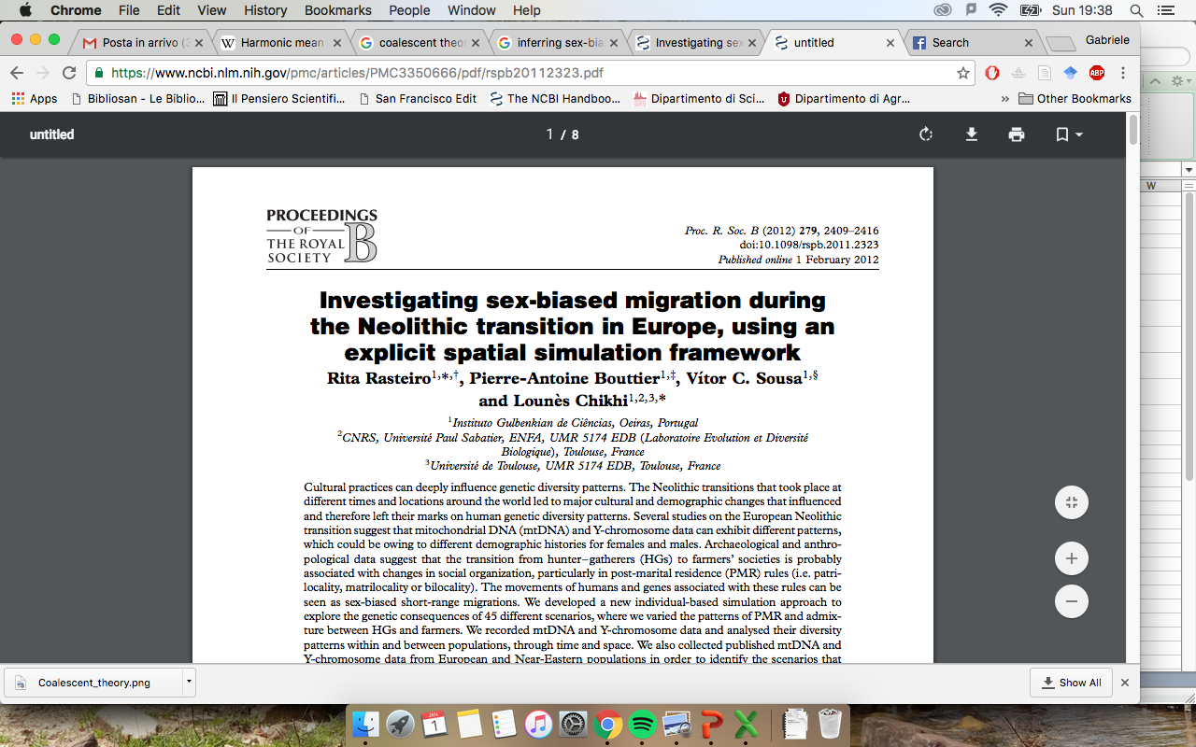
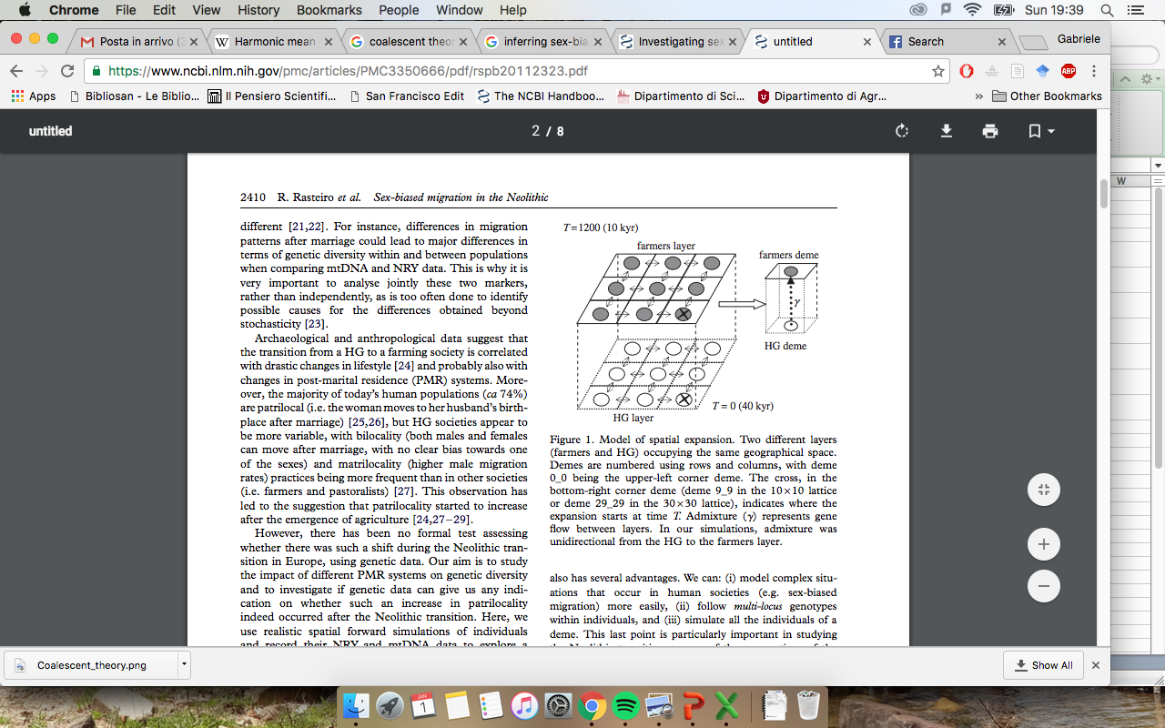
They tested different scenarios to identify which social organization would best explain present genetic data.

Slide 3
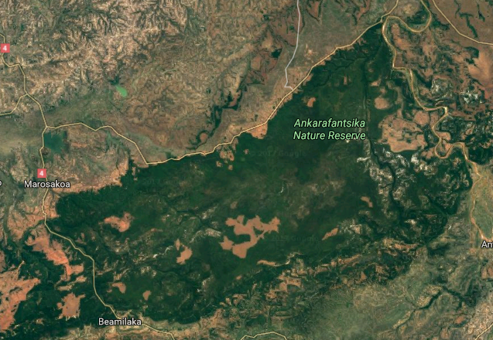
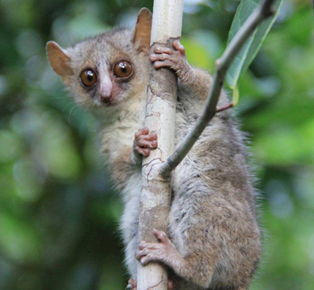
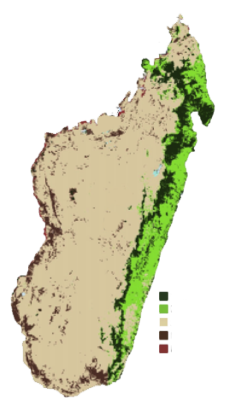
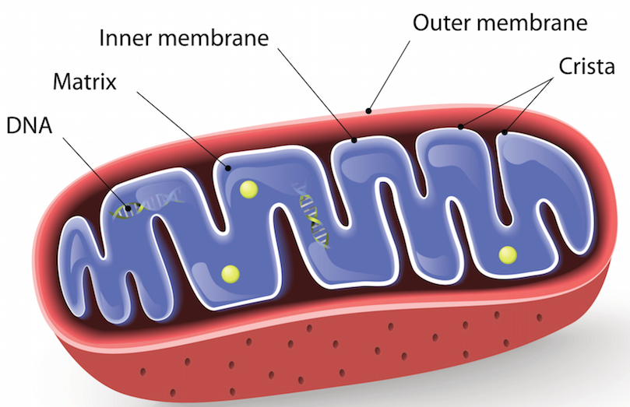
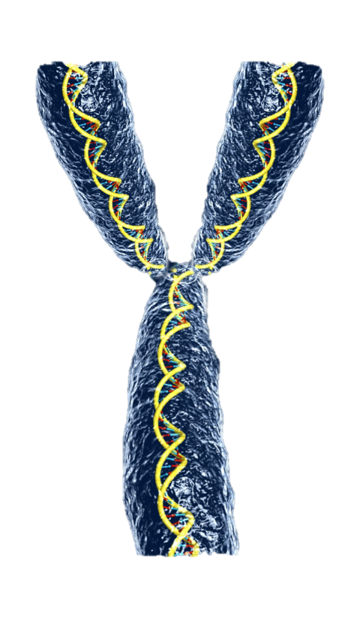
Fieldwork: genetic sampling
500 bp sequence from non-recombinant DNA
mtDNA
Y chromosome

Slide 4
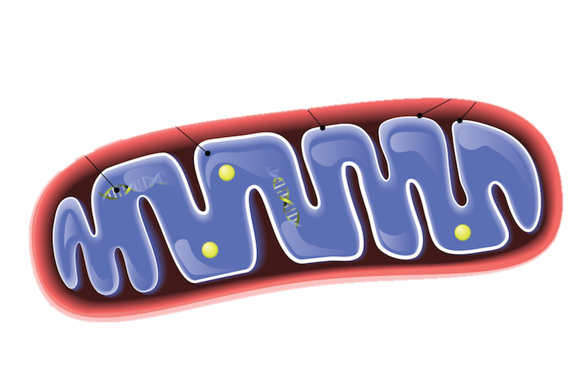
Maternally
inherited
Proxy of female demography
mtDNA
Paternally
inherited
Proxy of male demography
Y chromosome

Slide 5

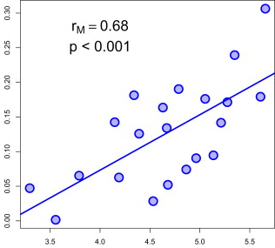
Isolation by distance (IBD)
Dispersal is localized in space, which means that individuals geographically close to each other are more likely to mate.
Tanabe et al. 2010
Pairwise genetic dist.
log(geo. dist.)
Main assumptions on the landscape:
Continuous
Homogenous (e.g. all sub-populations have same size)
The slope of the regression may be used to estimate 1/(4*N*π*m)

Slide 6
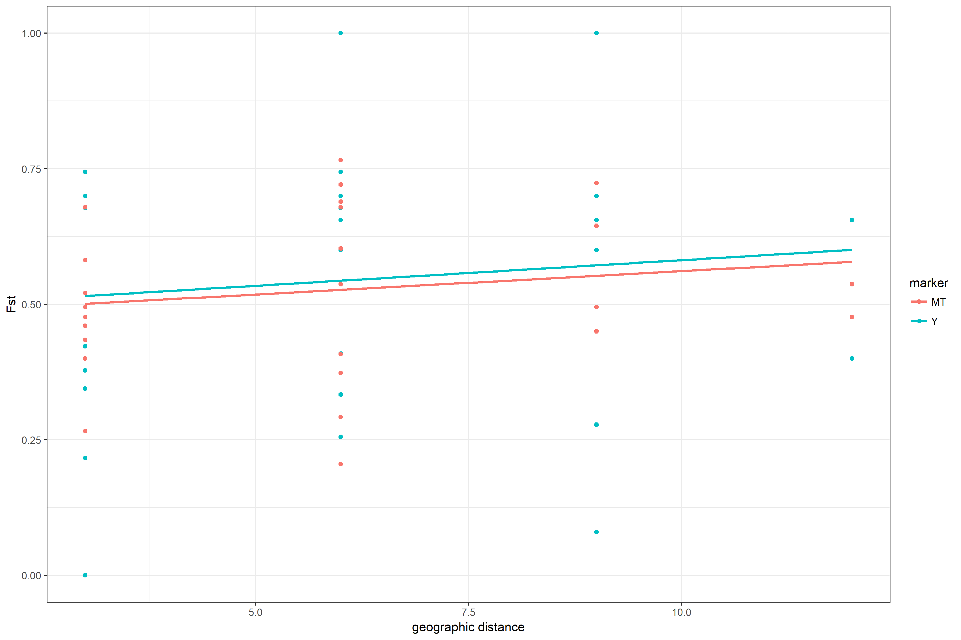
How would you explain the observed pattern?

Slide 7

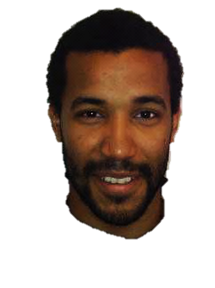
Behavioural ecologist
Male reproductive success: 10%

Slide 8

How would you explain the observed pattern?
Male reproductive success: 10%

Slide 9
Starting simulations of populations in space

Slide 10
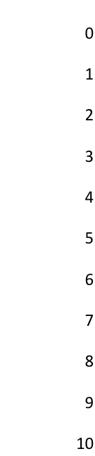
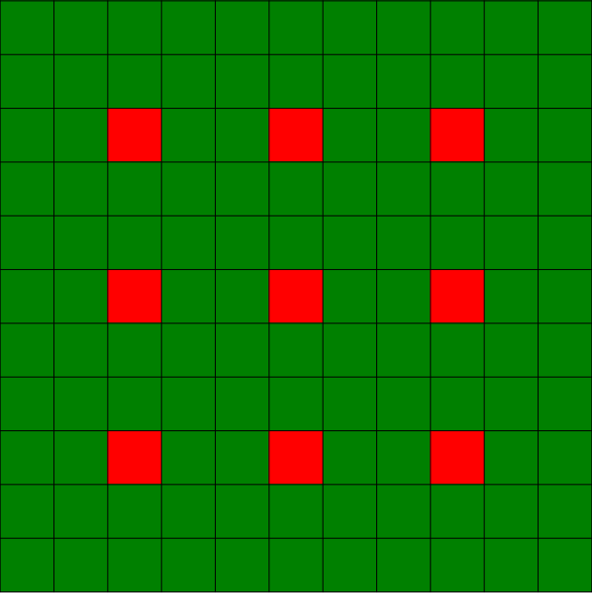
General settings:
Starting: whole world is filled
Population density: 100 ind. / deme
Difficulty to cross (F) : 0.01
Growth rate (r) : 0.8
Time of the simulation: 18.000 generations
Start Recording data: at generation 12000
Record genetic data every: 100 generations
Record demographic data every: 100 generations
Genetic marker settings:
Y chromosome:
Marker type: sequence
N° base-pairs: 500 bp
Mutation rate: 3 x 10⁻⁸ per base-pair/ generation
Mitochondrial DNA:
Marker type: sequence
N° base-pairs: 500 bp
Mutation rate: 3 x 10⁻⁸ per base-pair/ generation

Slide 11
Three possible scenarios to test…
Bilocal
&
migr. rate 0.1
Bilocal
&
migr. rate 0.01
Female philopatry
&
Male Reproductive success
reprodMale: 1
reprodFemale: 1
migrationRate: 0.1
msR 0.5
reprodMale: 1
reprodFemale: 1
migrationRate: 0.01
msR 0.5
reprodMale: 0.1
reprodFemale: 1
migrationRate: 0.1
msR 0.1
?
?
?

Slide 12
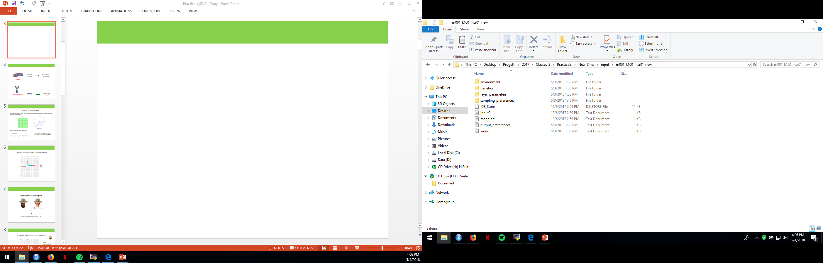
Input file
Open the “input_template” folder and modify according to the scenario that you want to simulate. You will find the following files:

Slide 13
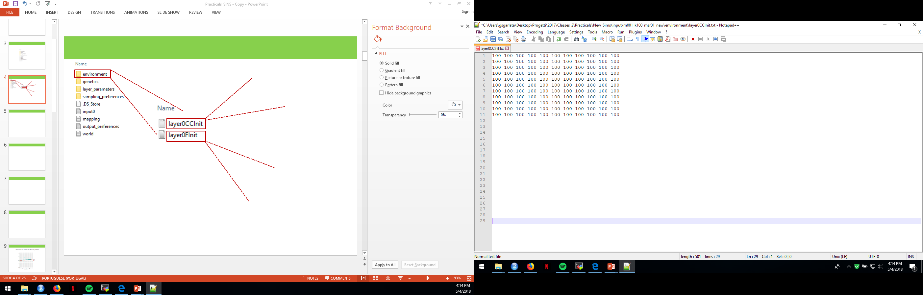
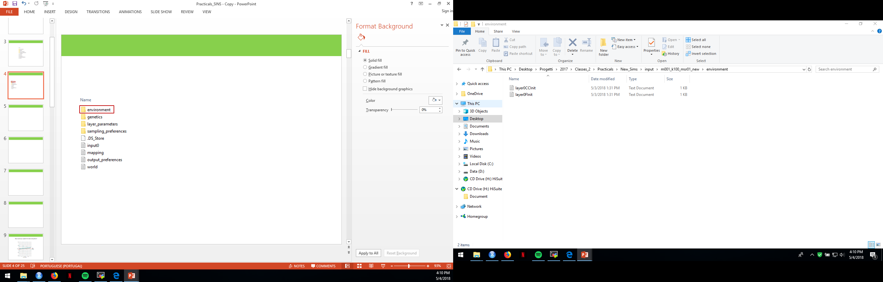
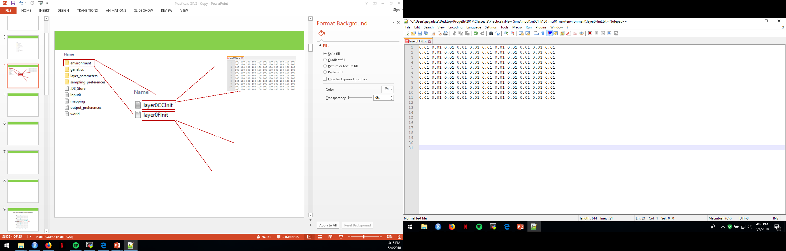
Environment folder
layer0CCInit: this is the file in which you can specify the carrying capacity of each population.
layer0FInit: this is the file in which you can specify the friction of each population, which defines the difficulty of the individuals to move into neighboring demes.

Slide 14
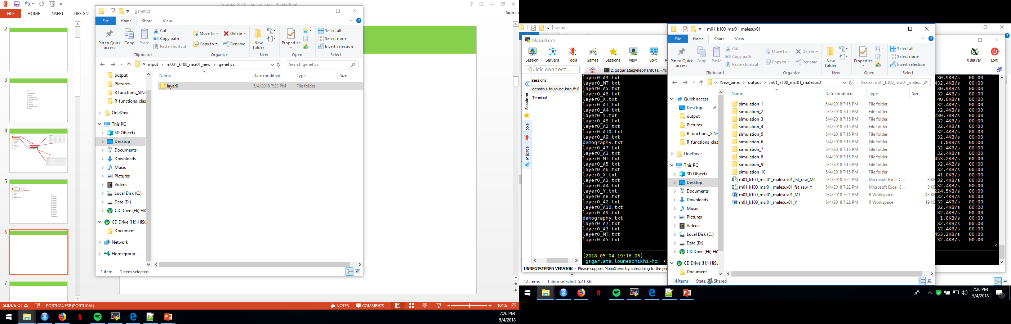
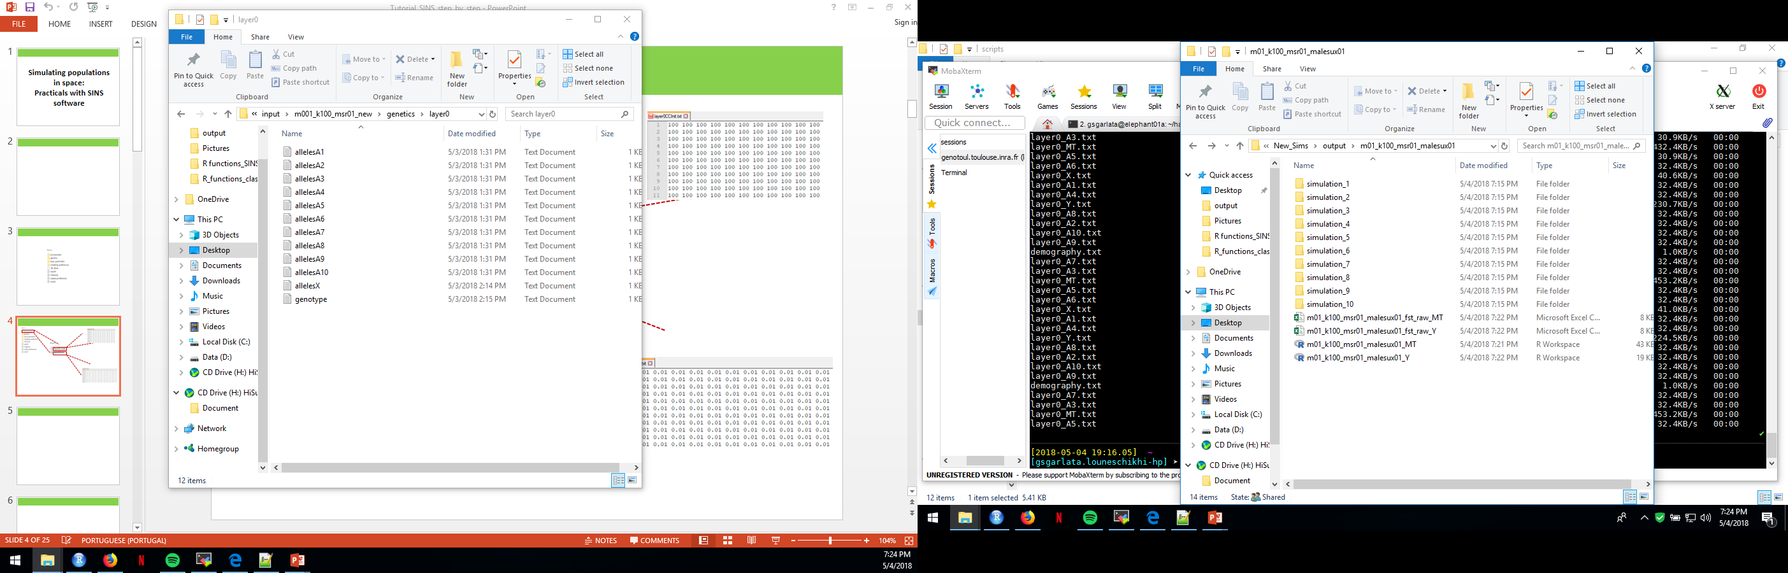
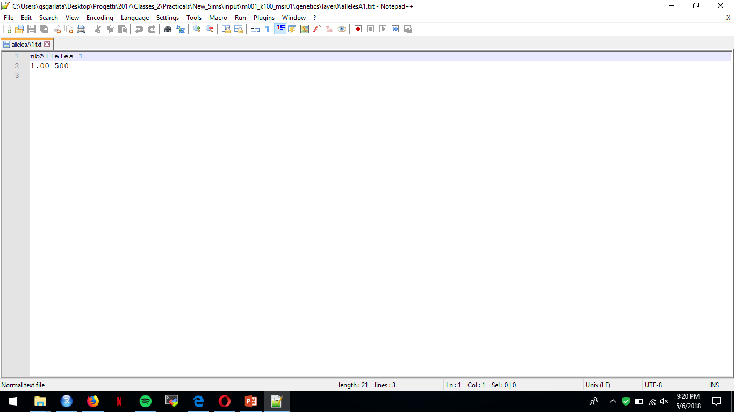
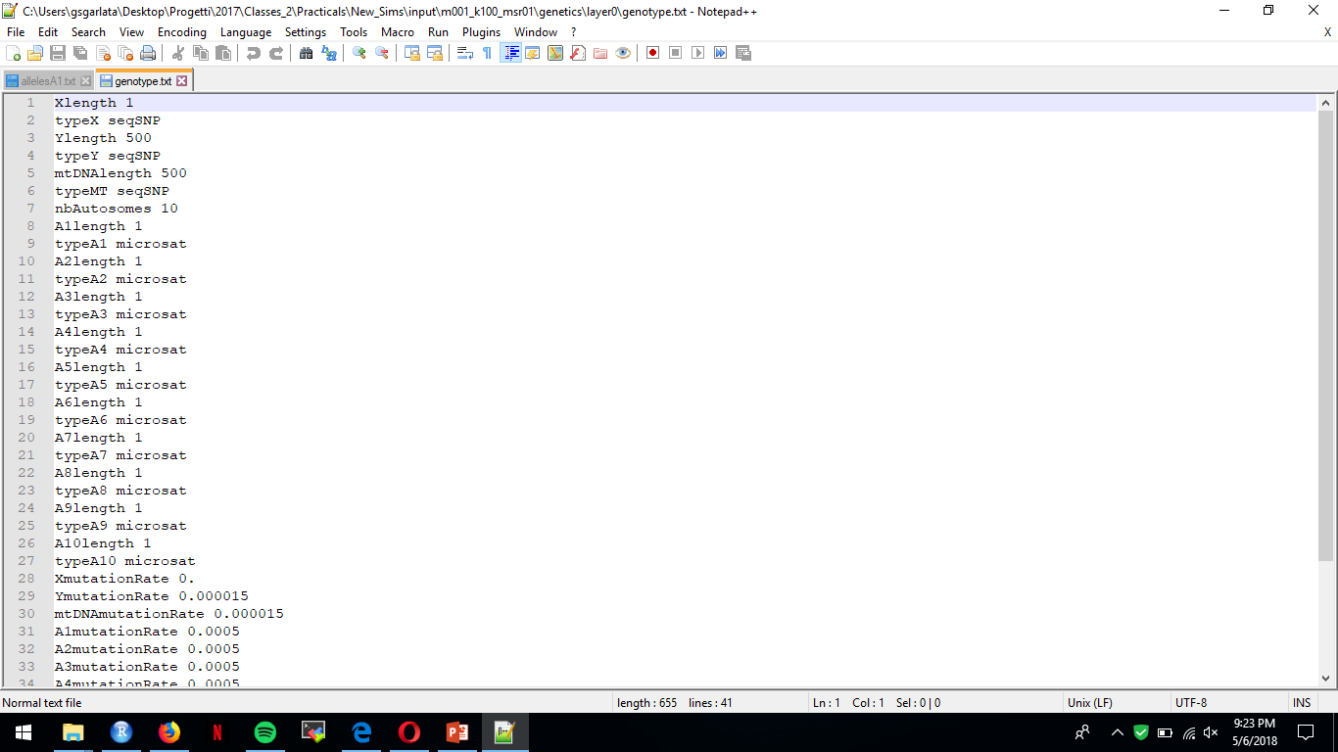
Genetics folder
In the genetics folder, it is contained the genetic information for each nuclear marker and (optionally) one for X chromosome and one for mtDNA.
allelesA#: text file defining the initial genetic information for marker #. First line specifies how many different alleles are present in each population for marker #. From Second line on, you specify frequency and allele (in the case of microsatellite, it corresponds to number of nucleotide repetitions)
Genotype: defines type (seqSNP or microsat), length and mutation rate for each genetic marker.

Slide 15
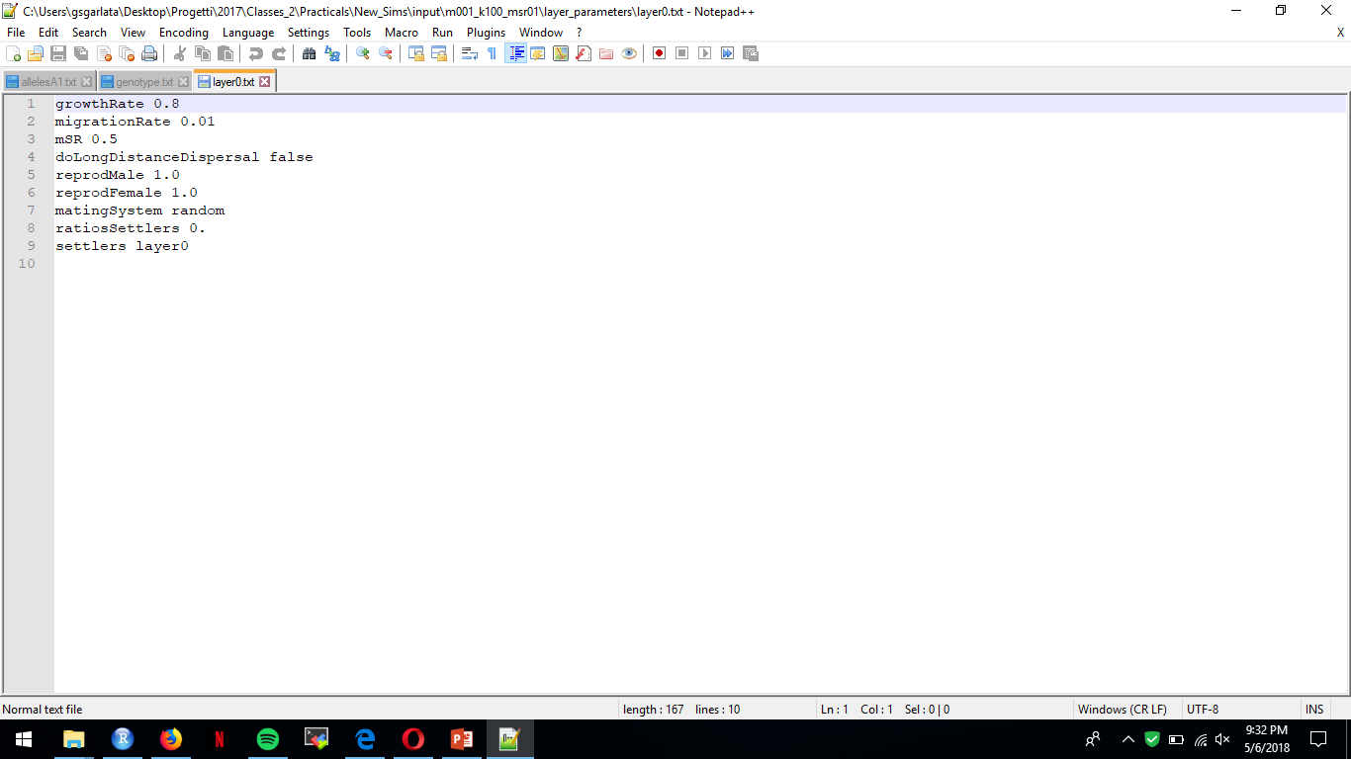
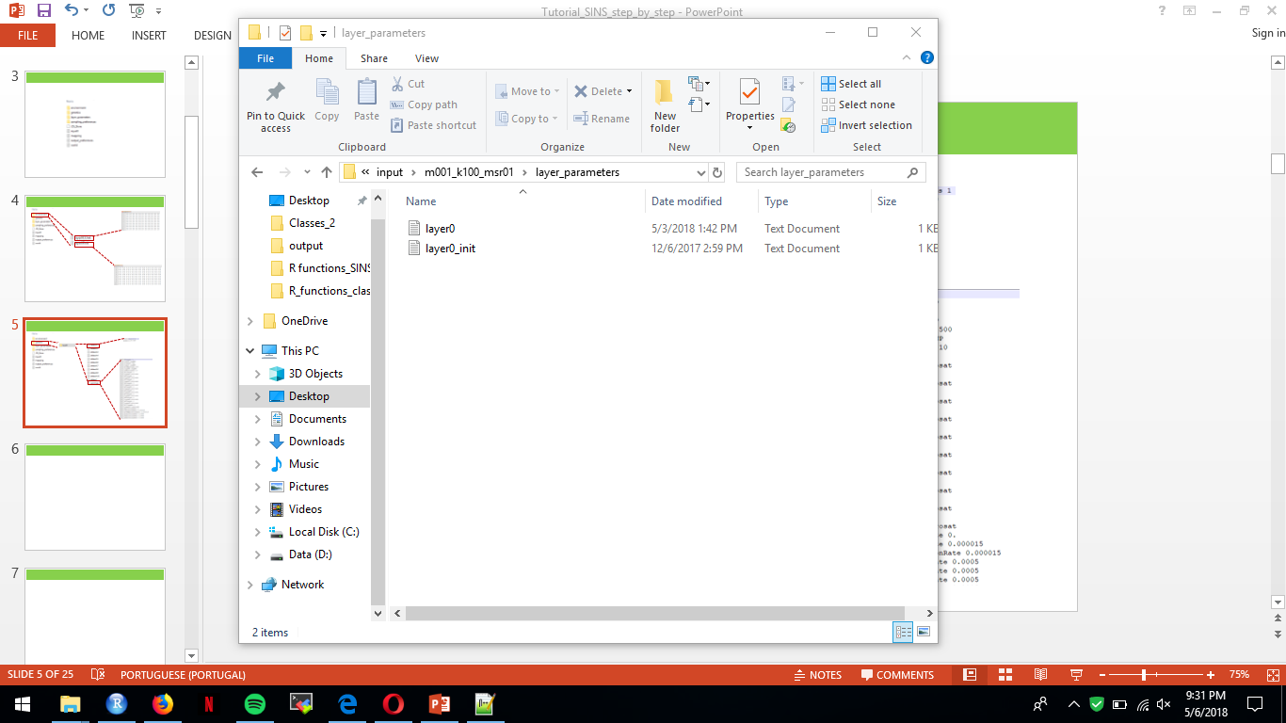
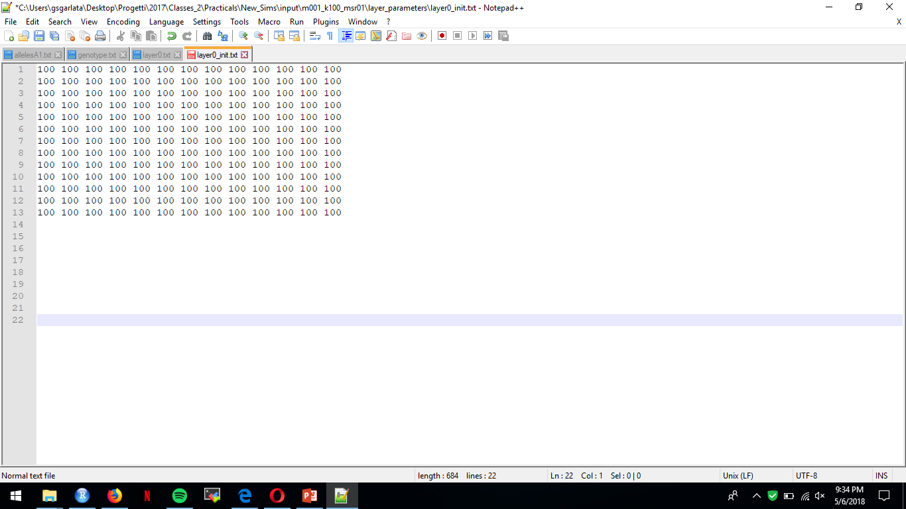
layer_parameters
layer0: this file defines the behavioral ecology of the simulated species/population.
growth rate, regulates the logistic growth of the population at each generation
migrationRate, percentage of migrating individuals for each population
mSR: sex-biased dispersal. If > 0.5 females migrate more than males, if < 0.5 females migrate less than males.
reprodMale/Female: specify the reproductive success of males and females, that is the percentage of reproductive males/females.
layer0_init: this file defines the initial landscape of the simulated scenario.

Slide 16
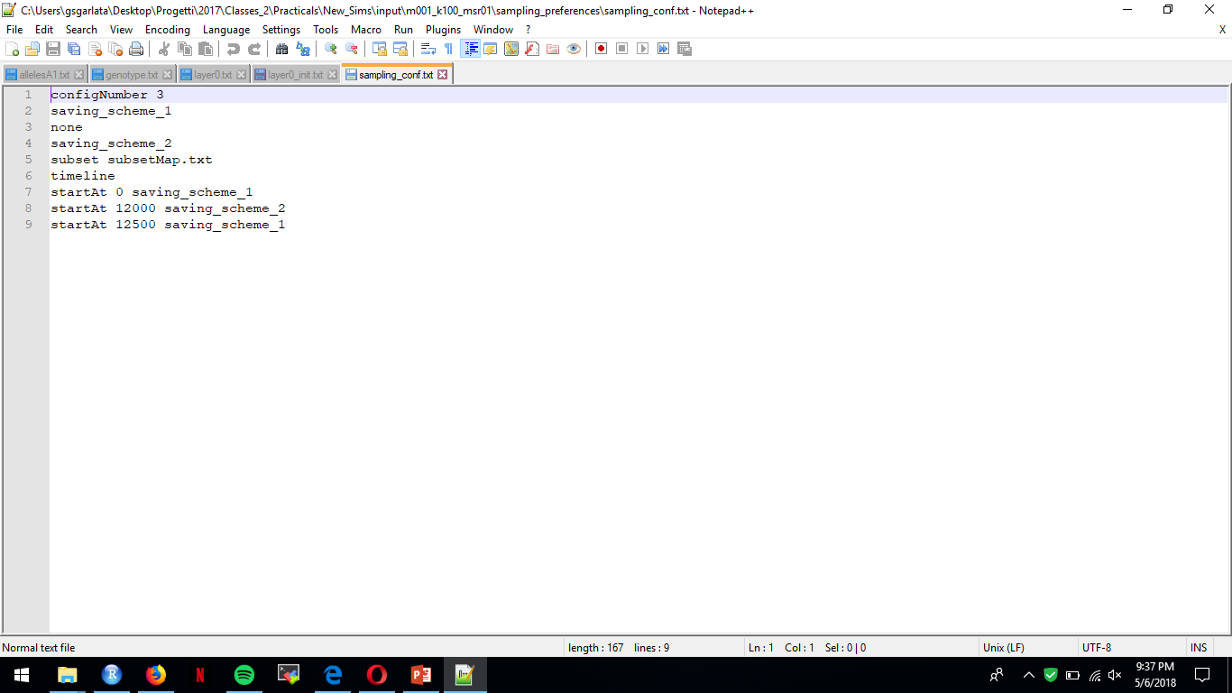
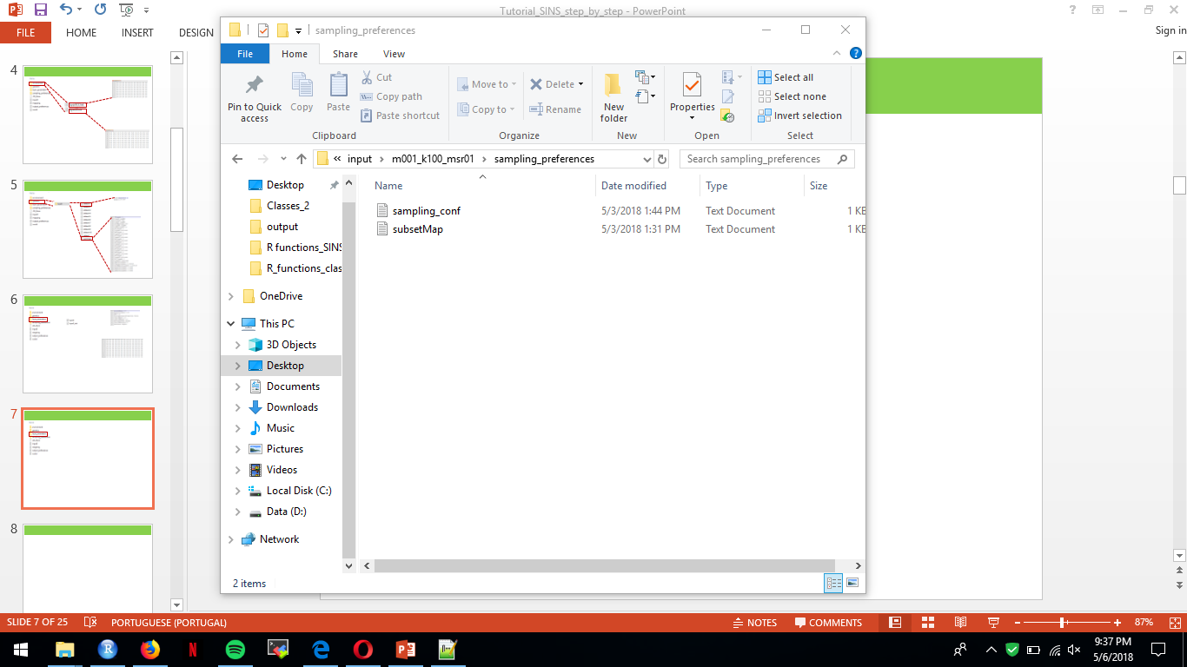
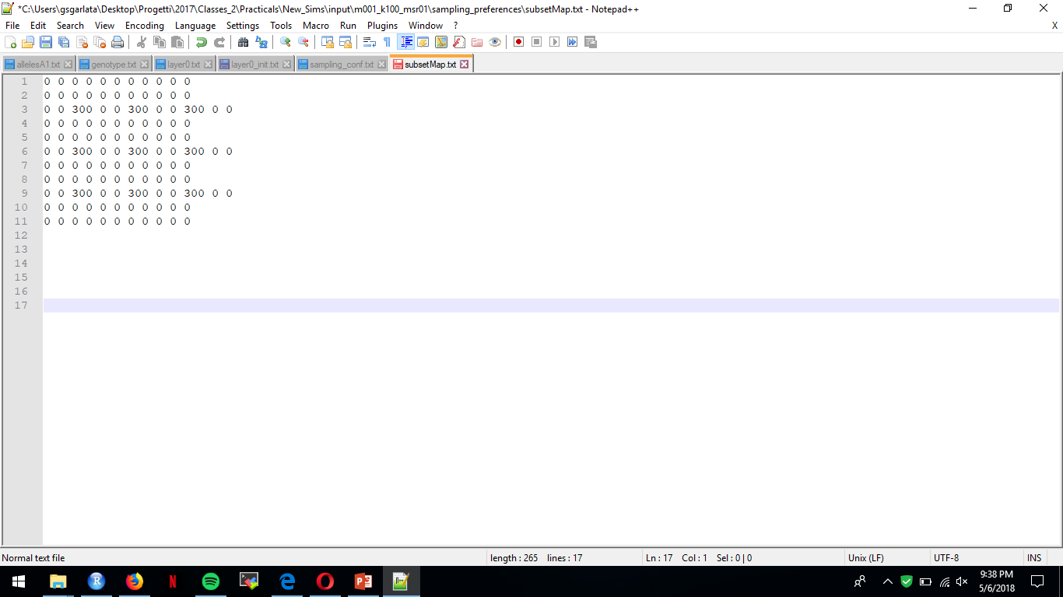
sampling_preferences
sampling_conf: this file defines the sampling strategy along the whole simulation.
configNumber, defines how many different sampling schemes are specified.
saving_scheme#, list the sampling scheme by referring to another file text present in the same folder (“subsetMap.txt”). If none, no information will be saved.
timeline, defines the time points in which the user wants to switch from one sampling scheme to another.
subsetMap: specifies which population and how many individuals will be sampled.

Slide 17
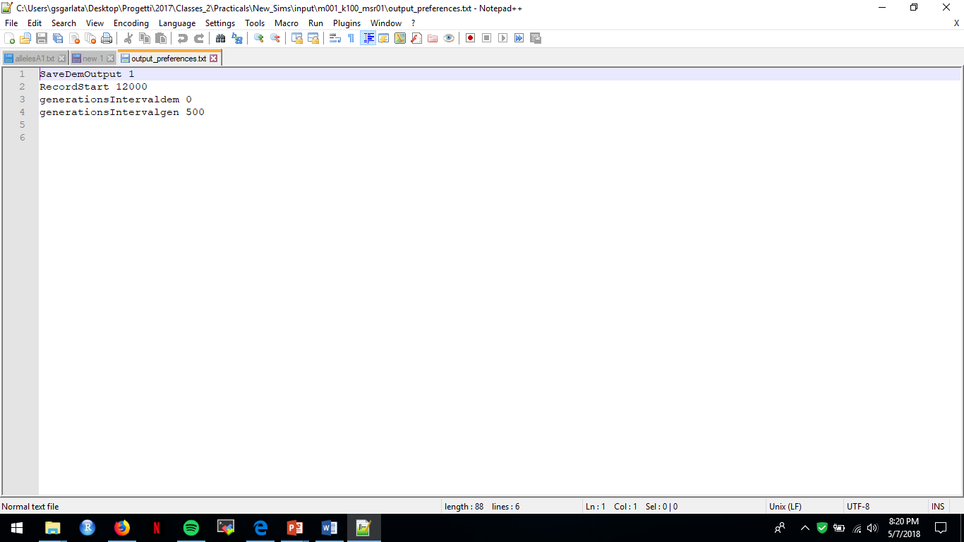
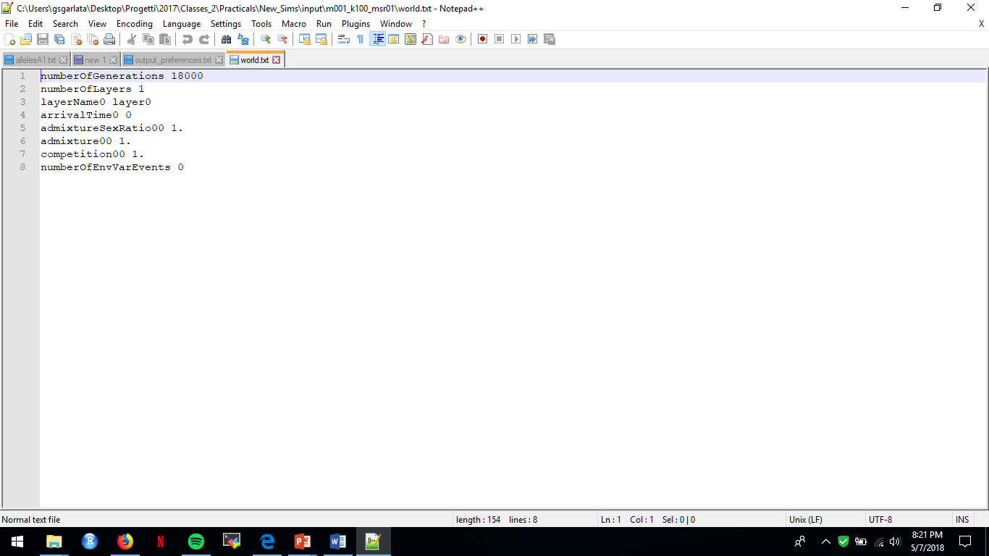
Main parameters and output
output_preferences: this file defines when starting to record demographic and genetic information, and at which frequency (e.g. 0 = no demographic data recorded, 500 = genetic data are recorded every 500 generations).
world: this file provides general information on how many generations (time) will be simulated and other details not of relevance for the present practical.

Slide 18
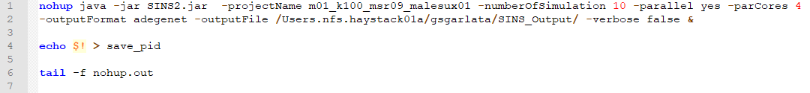
Run SINS software
Open SINS2.sh file
“-projectName”: defines the name of the scenario that you want to simulate
“-numberOfSimulation”: defines the number of repetition for specified scenario
“-parallel”: defines if the # replicates of the specified scenario will be simulated in parallel (yes) or not (no)
“-outputFile” defines the path in which the output of the simulation will be saved
“-verbose” argument is true if you want realt time information on the status of the simulations.
Save the changes applied to SINS2.sh file.
Run SINS by typing “./SINS2.sh”

Slide 19
Data analysis:
compare the observed IBD pattern with the simulated scenarios

Slide 20
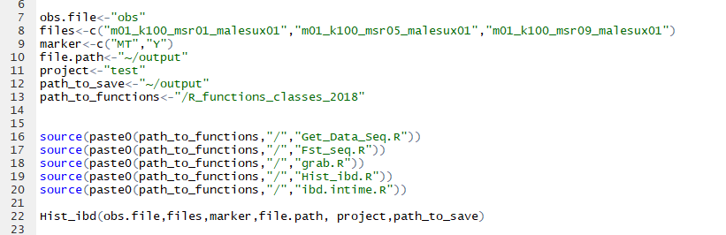
Data analysis
Open “Pipeline_classes.R” script
obs.file: this object specifies the name of the folder containing the data on the observed IBD pattern.
files: list the names of the scenarios to compare with the observed IBD pattern.
marker: specifies the genetic markers, in this case we are comparing both mtDNA and Y-chromosome, therefore keep “MT” and “Y”.
file.path: defines the path in which the output data of the simulated scenarios are located.
project: name of the plot that will be saved after the analysis of the data in the pipeline.
path_to_save: defines the path in which the plot will be saved.
path_to_functions: defines the location of the R functions used in the data analysis.
Hist_ibd: it is the function used to compare the observed IBD pattern with a list of simulated scenarios. The output will be saved in “path_to_save”.

Slide 21
Data analysis
Bilocal
&
migr. rate 0.1
Bilocal
&
migr. rate 0.01
Female philopatry
&
Male Reproductive success
Names of the outputfiles of the three possible scenarios that you have simulated
m01_k100_msr05
m001_k100_msr05
m01_k100_msr01_malesux01
Now, compare the observed pattern (“obs” file) with one of the three scenarios

Slide 22
Data analysis
If you are curious, the output of other simulated scenarios are available
m01_k100_msr01: migration rate 0.1, Carrying capacity 100 and female philopatry.
m01_k100_msr05: migration rate 0.1, Carrying capacity 100 and bilocality.
m01_k100_msr09: migration rate 0.1, Carrying capacity 100 and male philopatry.
m001_k100_msr01: migration rate 0.01, Carrying capacity 100 and female philopatry.
m001_k100_msr05: migration rate 0.01, Carrying capacity 100 and bilocality.
m001_k100_msr09: migration rate 0.01, Carrying capacity 100 and male philopatry.
m01_k100_msr01_malesux01: migration rate 0.01, Carrying capacity 100, female philopatry and male reproductive success 10%.
m01_k100_msr05_malesux01: migration rate 0.01, Carrying capacity 100, bilocality and male reproductive success 10%.
m01_k100_msr09_malesux01: migration rate 0.01, Carrying capacity 100, male philopatry and and male reproductive success 10%.

Slide 23
Results
&
Discussion

Slide 24
How would you explain the observed pattern?

Slide 25
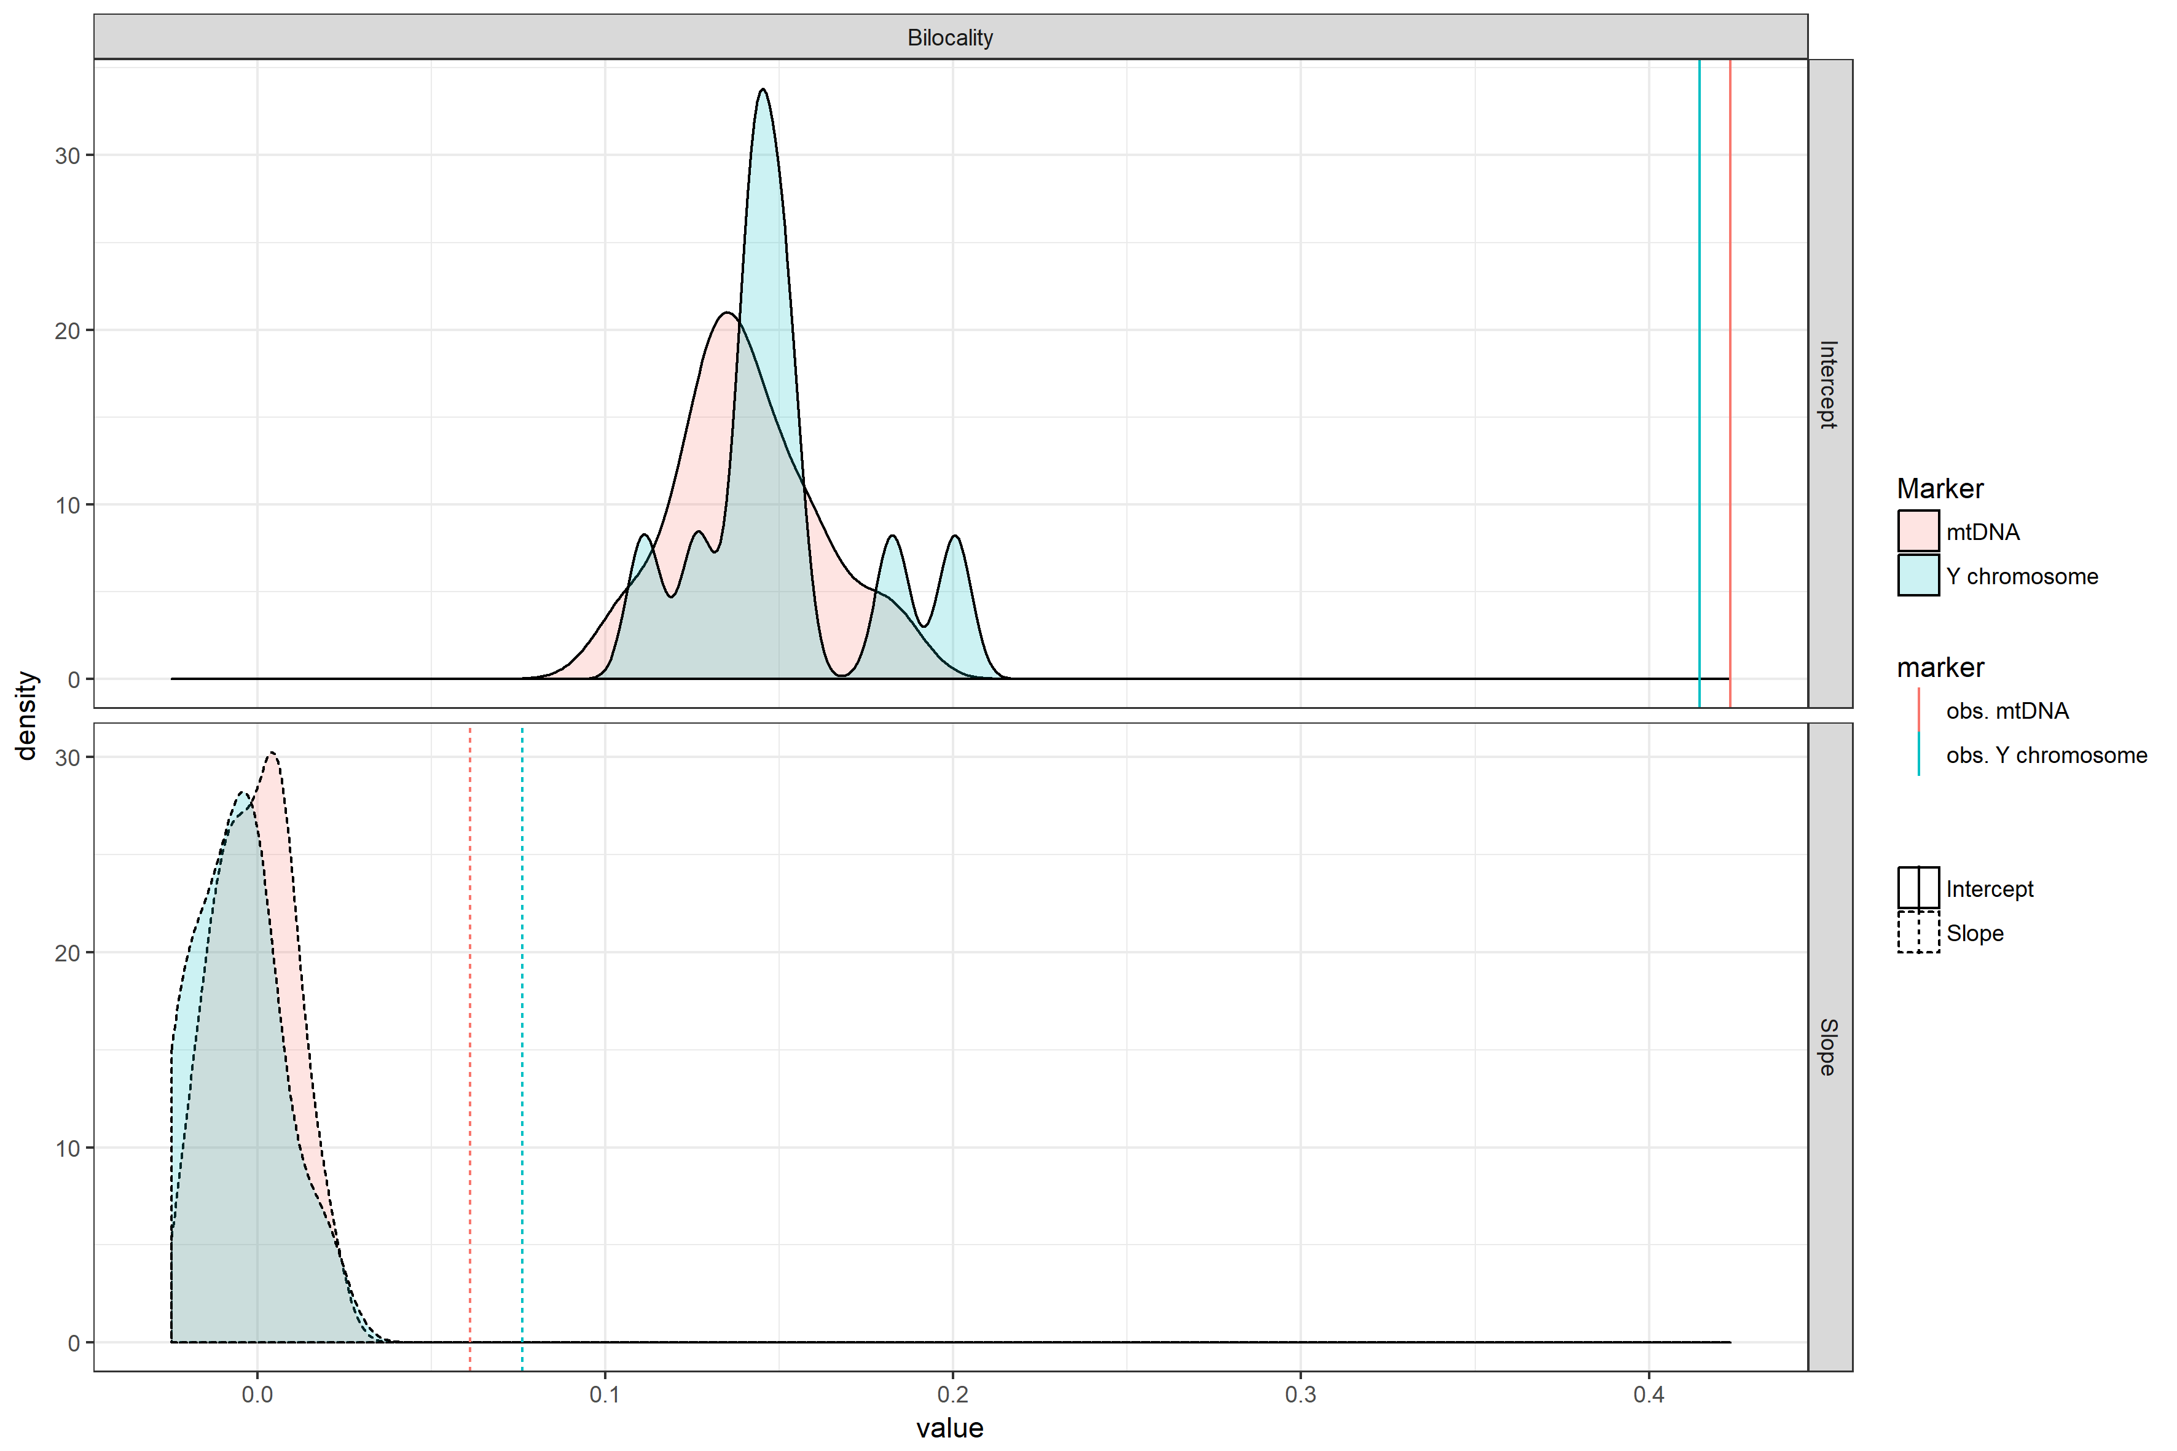
Bilocal (msR 0.5) & migr. rate 0.1

Slide 26
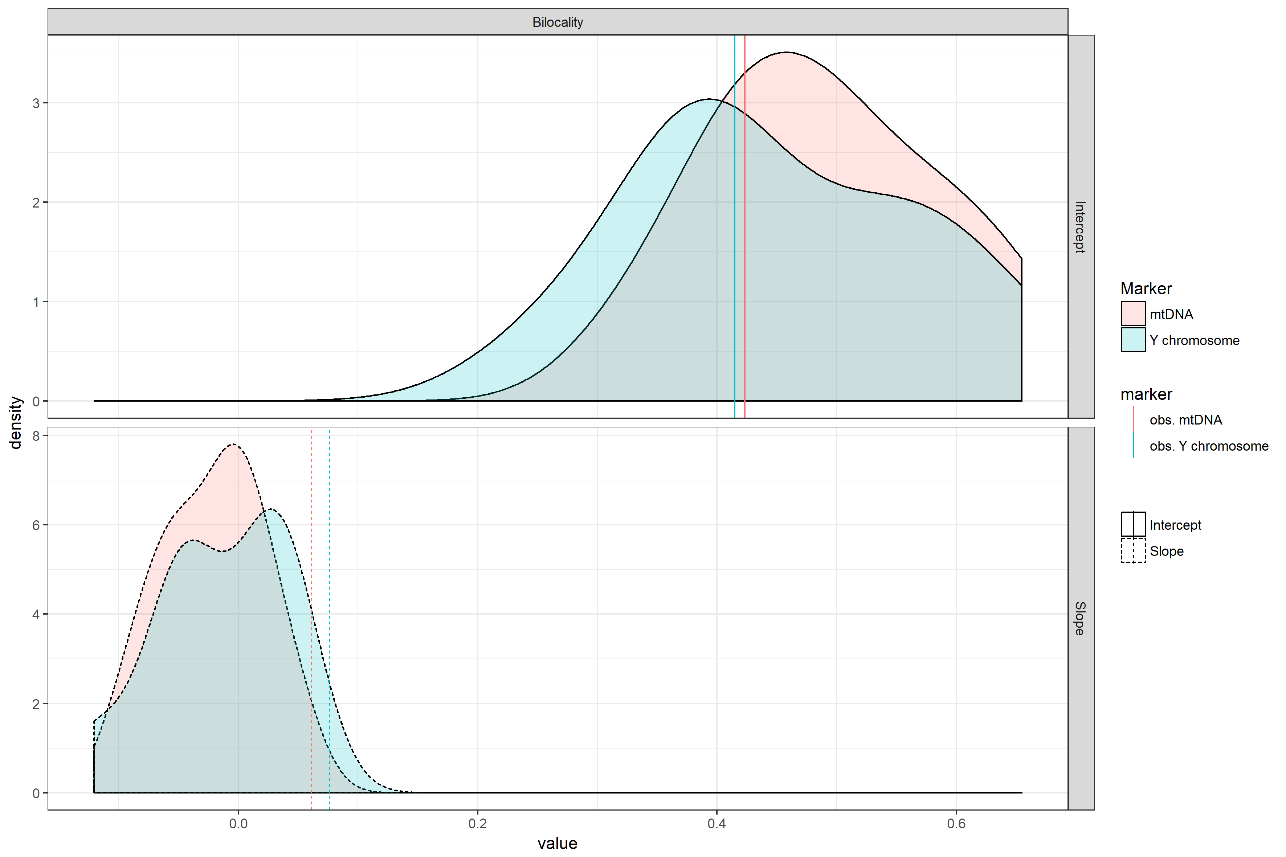
Bilocal (msR 0.5) & migr. rate 0.01

Slide 27
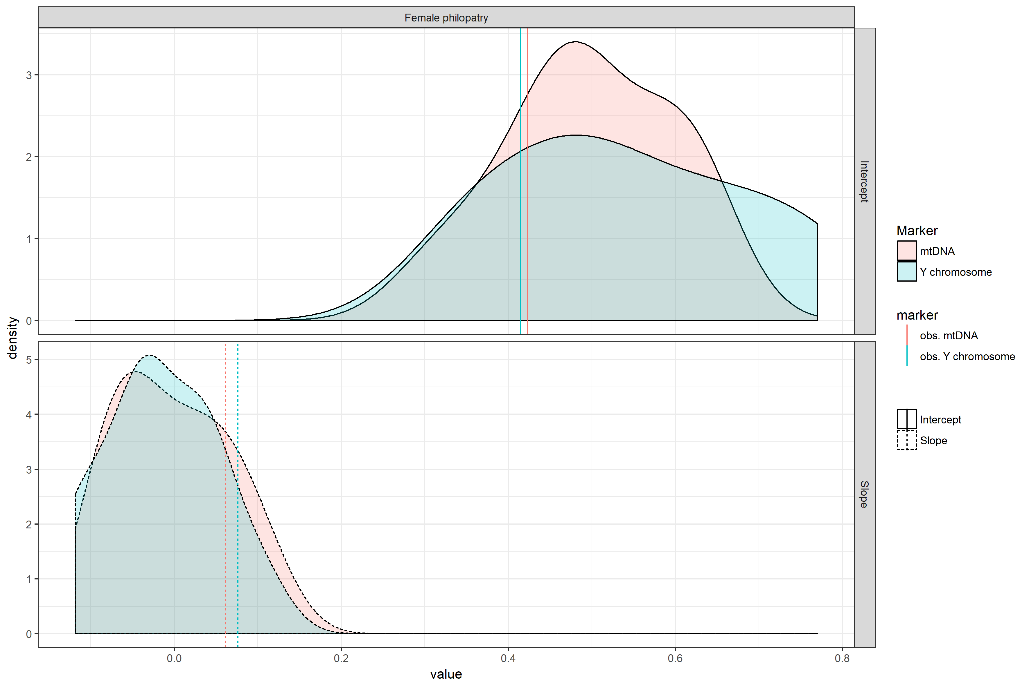
Migr. Rate 0.1, Female philopatry (msR 0.1) & Male Reproductive success 0.1

Slide 28
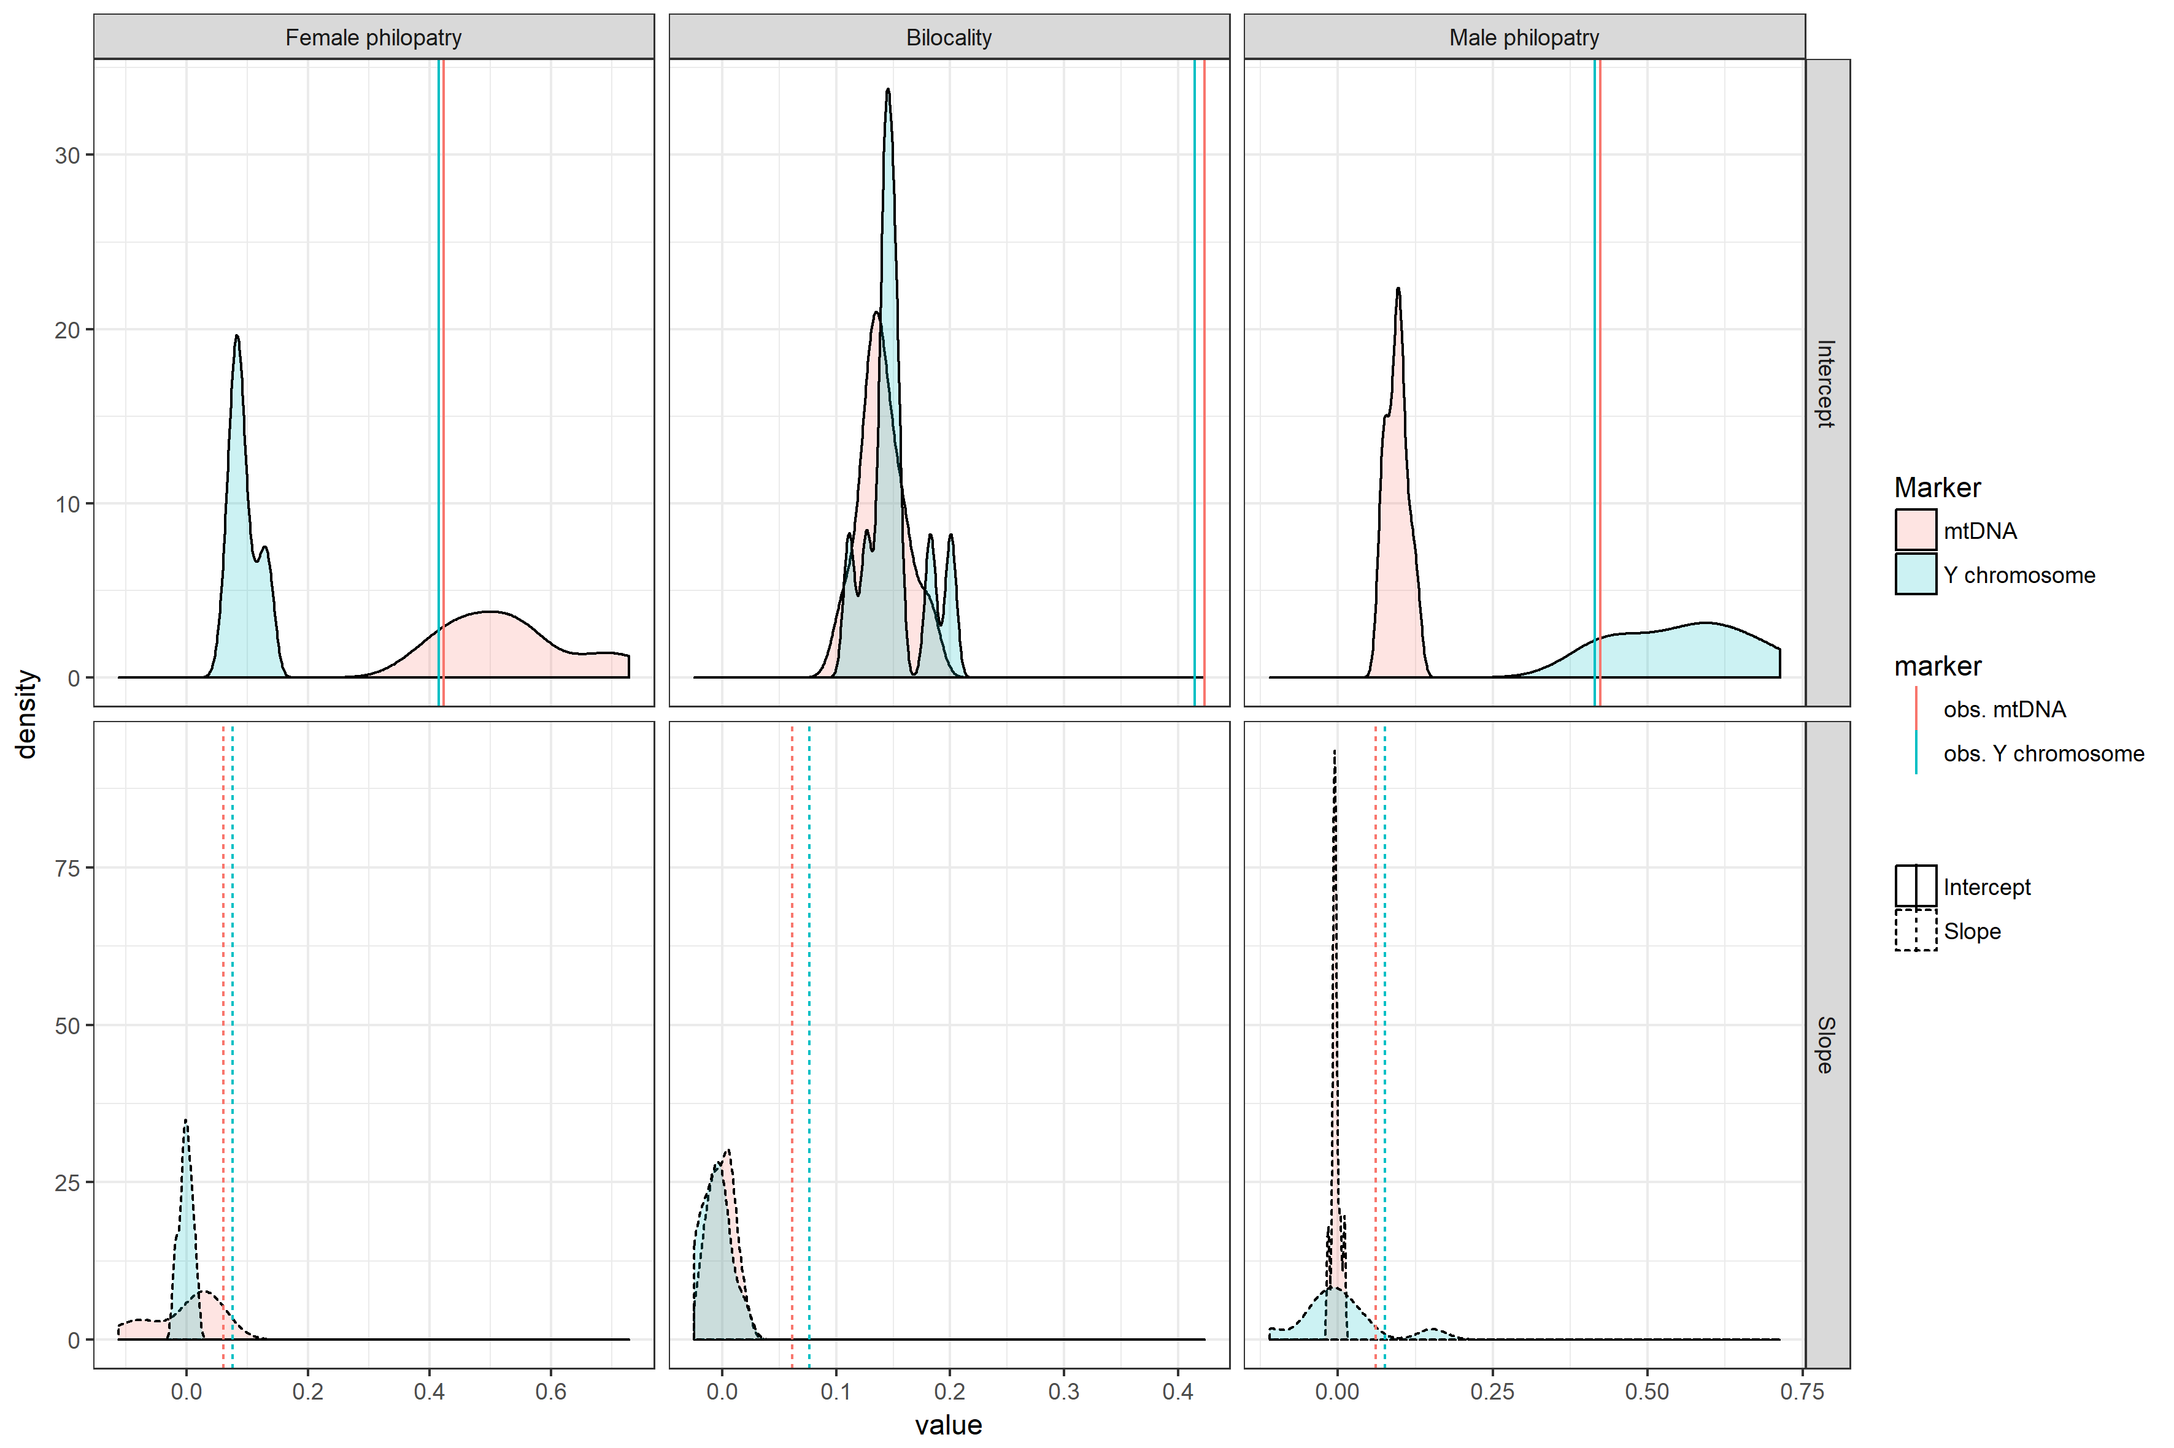
Bilocal & migr. rate 0.1
msR 0.1
msR 0.5
msR 0.9

Slide 29
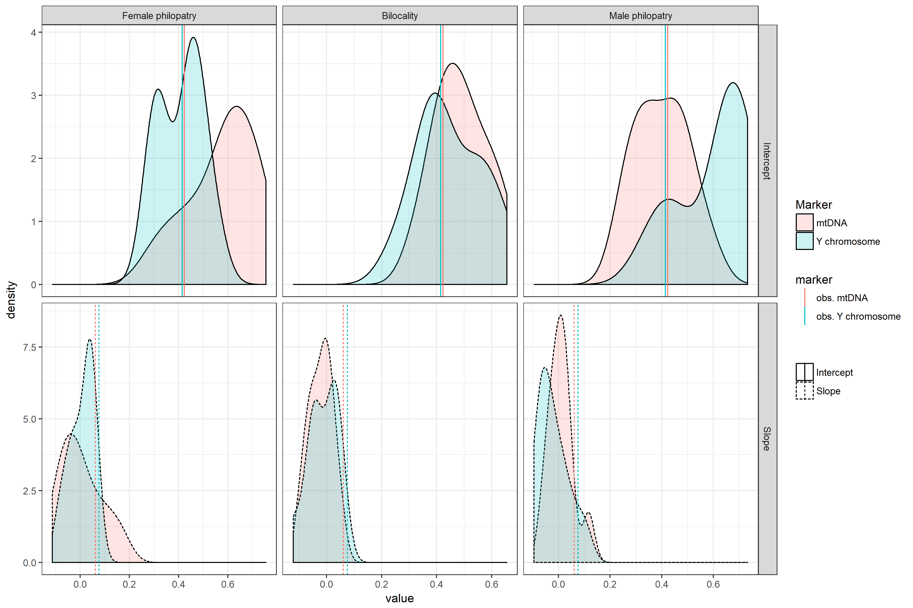
Bilocal & migr. rate 0.01
msR 0.1
msR 0.5
msR 0.9

Slide 30
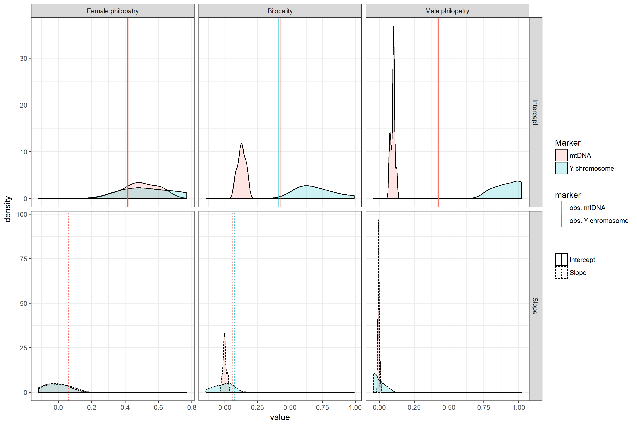
Migr. Rate 0.1, Female philopatry & Male Repr. success 0.1
msR 0.1
msR 0.5
msR 0.9

Slide 31
That pattern was obtained by simulating a population with migr. rate 0.1, female phylopatry (msR 0.1) and male reproductive success 0.1

Slide 32
Conclusions

